Slide 1
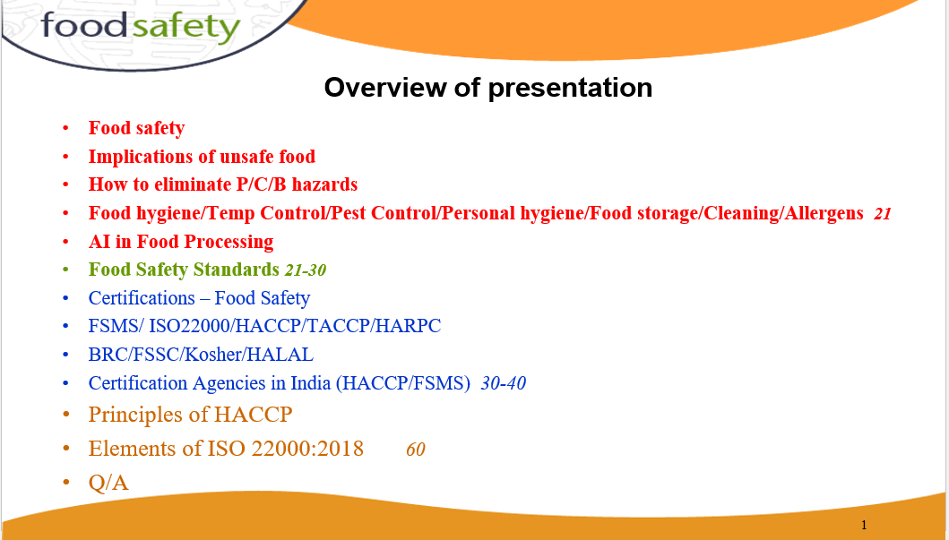

Slide 2
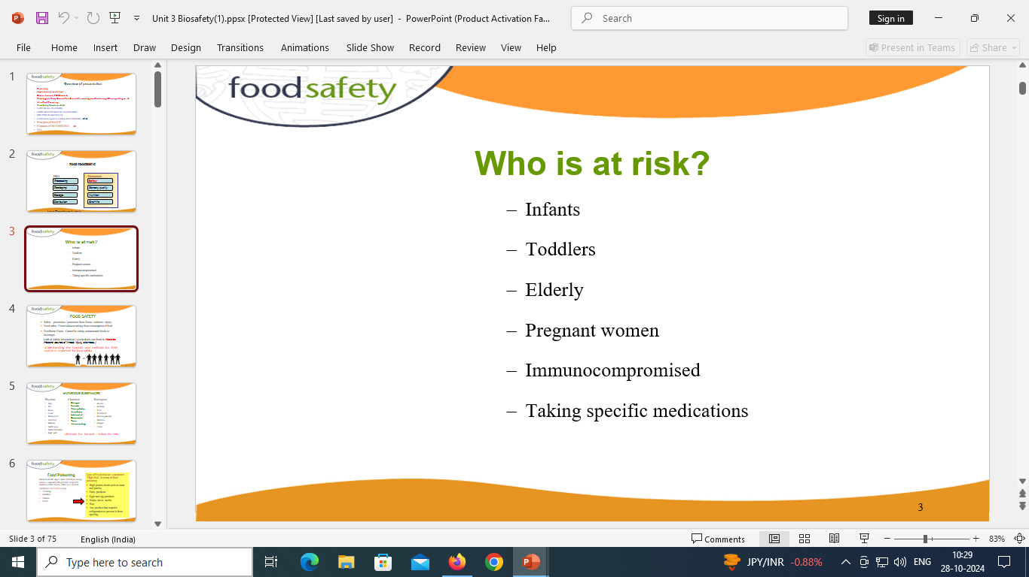



Slide 3
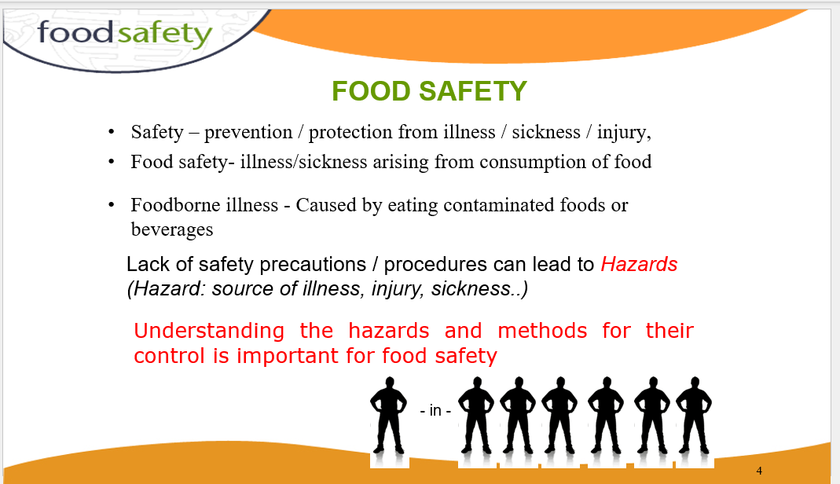

Slide 4


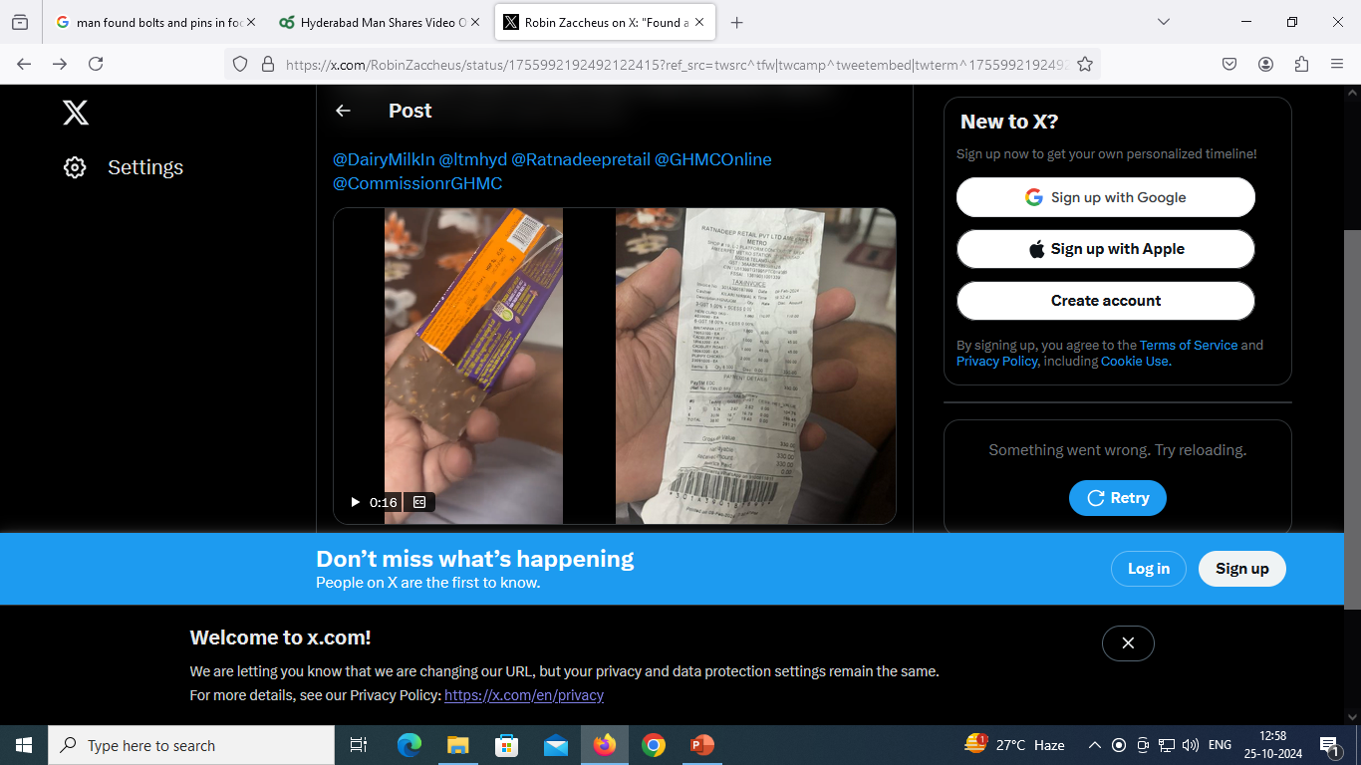


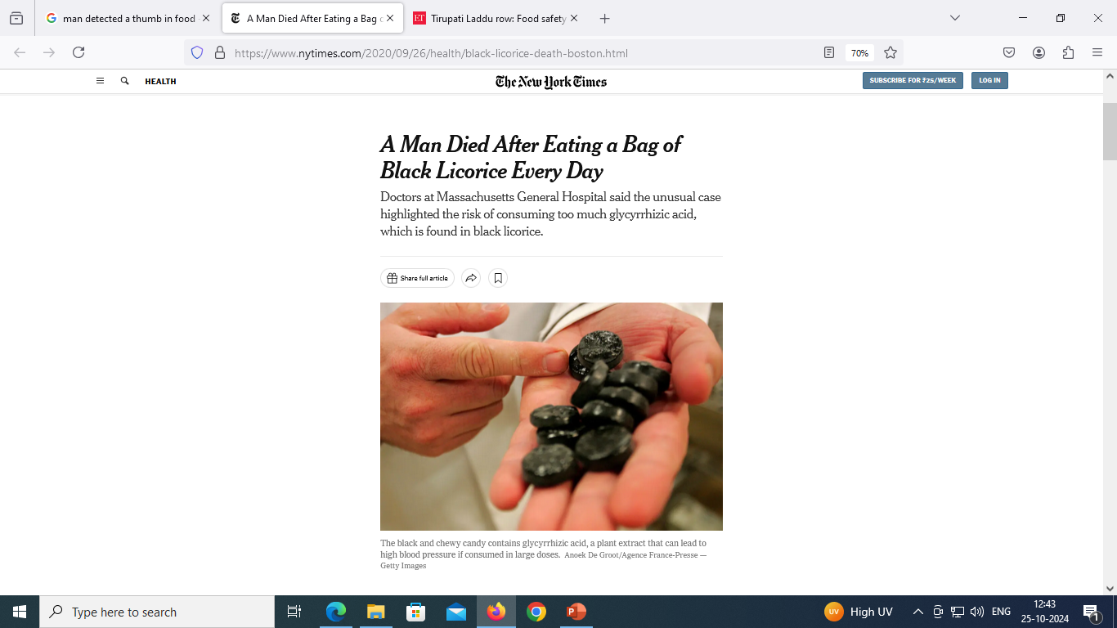


Slide 5
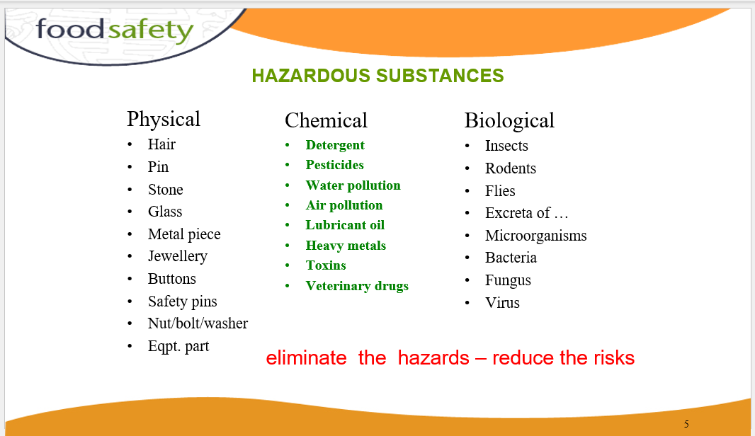

Slide 6
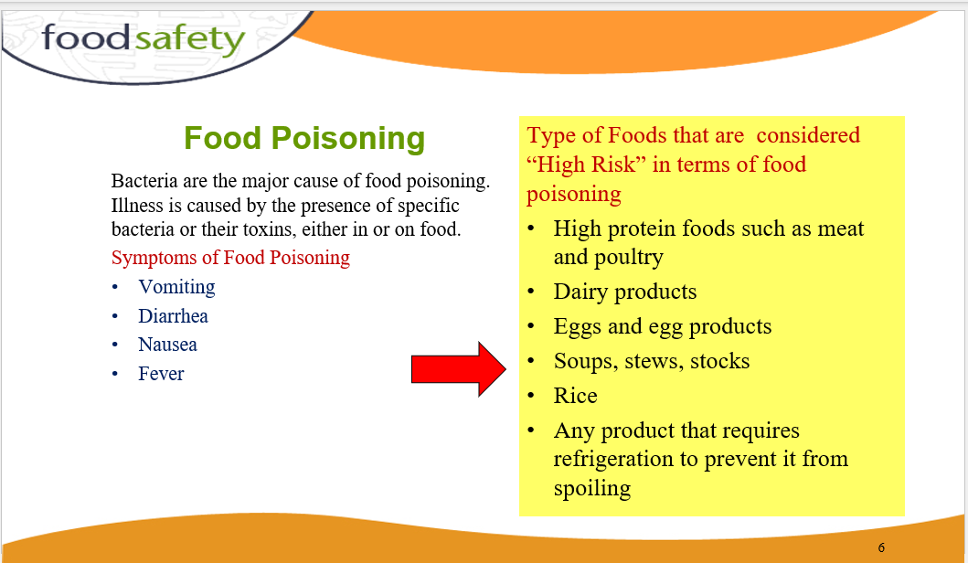

Slide 7
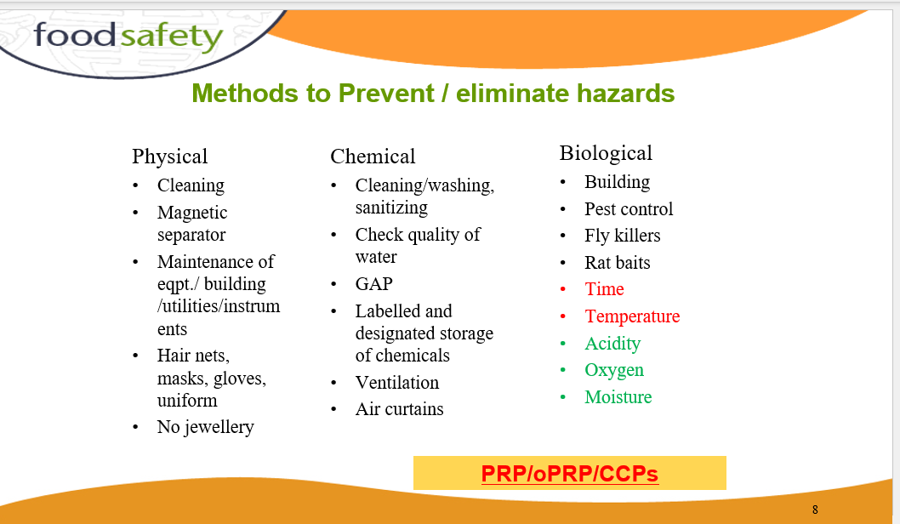

Slide 8
BASIC RULES OF HYGIENE, SANITATION AND SAFETY IN FOOD PROCESSING
Facilities required in the processing room
A changing room where clothing and shoes that are not worn for work can be stored. Separate hand-washing facilities for staff, with soap, clean water, nail brushes and clean towels or hot-air hand dryers. Hand-washing facilities should not be used for washing equipment.
Toilets, which should be separated from the processing room by two doors or located in a nearby building.
First aid materials.
Protective aprons or coats washed regularly, hats/hairnets, and if necessary, gloves and shoes/boots.
Cleaning chemicals, stored away from the processing room.

Slide 9
Hygiene and sanitation
Personal hygiene
Wear a hat/hairnet that completely covers the hair. Do not comb your hair in a processing room or storeroom.
Cover all cuts, burns, sores and abrasions with a clean, waterproof dressing.
Do not smoke or eat in any room where there is open food because bacteria can be transferred from the mouth to the food.
Do not spit in a processing room or storeroom.
Wash hands and wrists thoroughly with soap after using the toilet, eating, smoking, coughing, blowing your nose, combing your hair, handling waste food, rubbish or cleaning chemicals. Dry them on a clean towel before handling food again.
Keep finger nails cut short.
Do not wear perfume or nail varnish as these can contaminate products.
Do not handle any food if you have sores, boils, septic spots, a bad cold, chest infection, sore throat or a stomach upset. Report any of these to the manager and do alternative work.
Do not cough or sneeze over food.

Slide 10
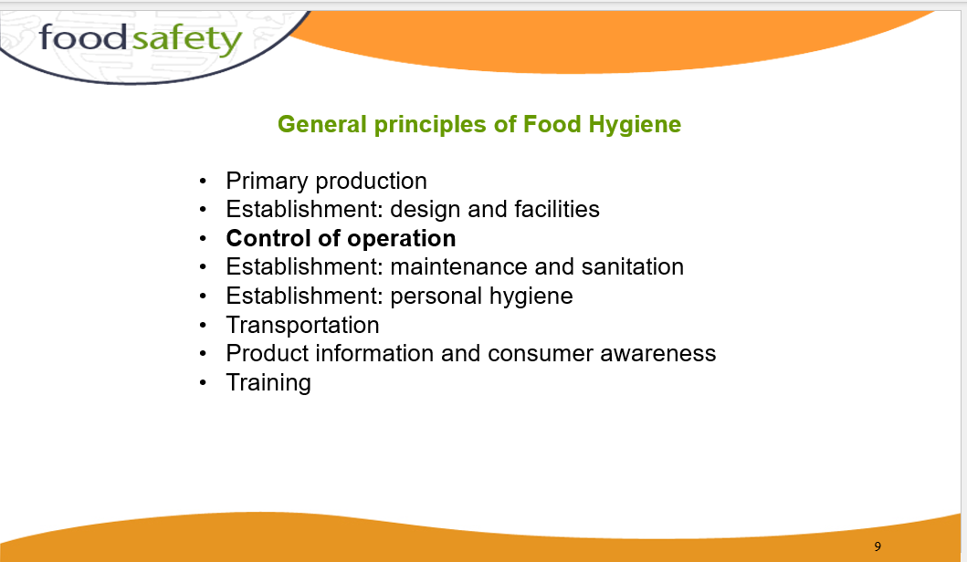

Slide 11
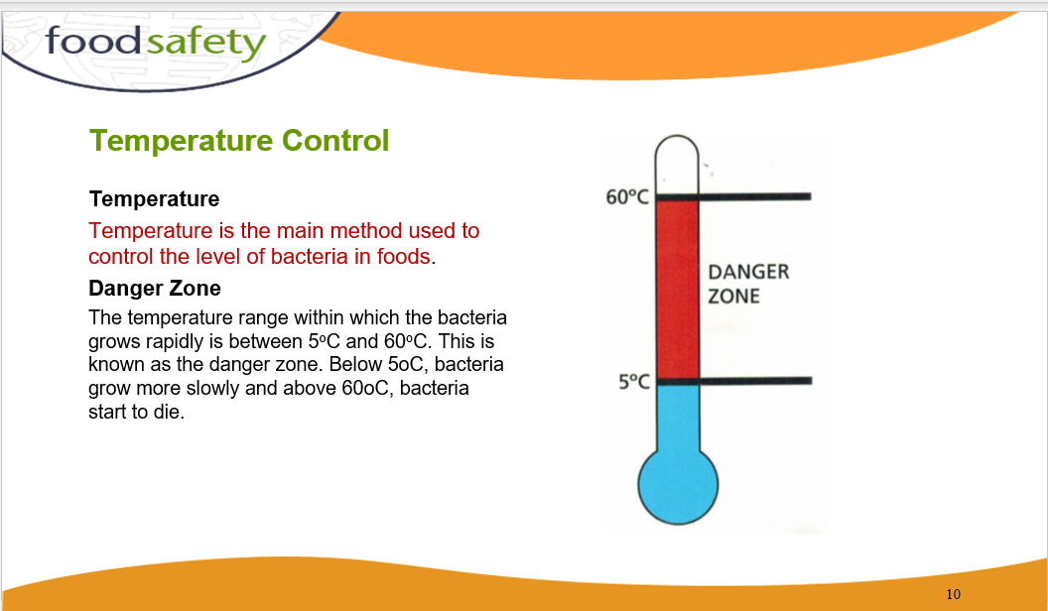

Slide 12
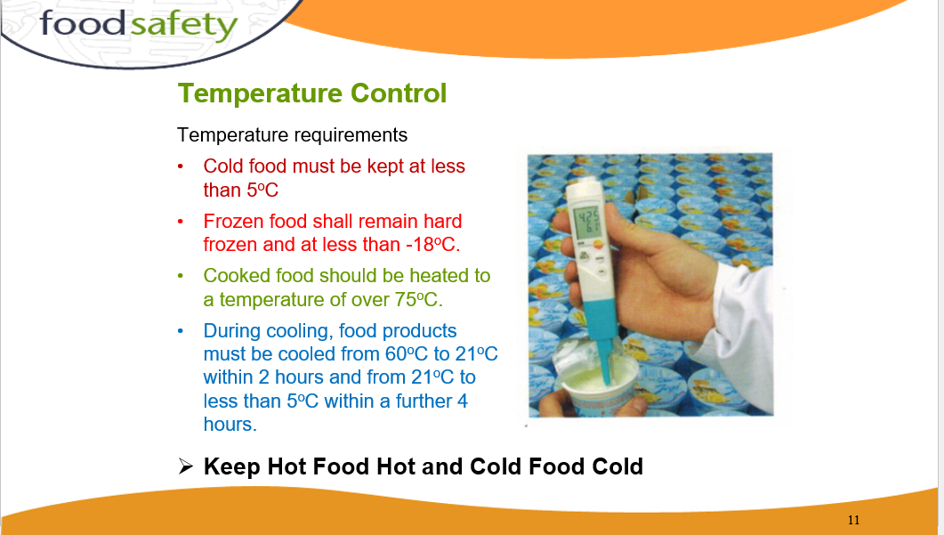

Slide 13
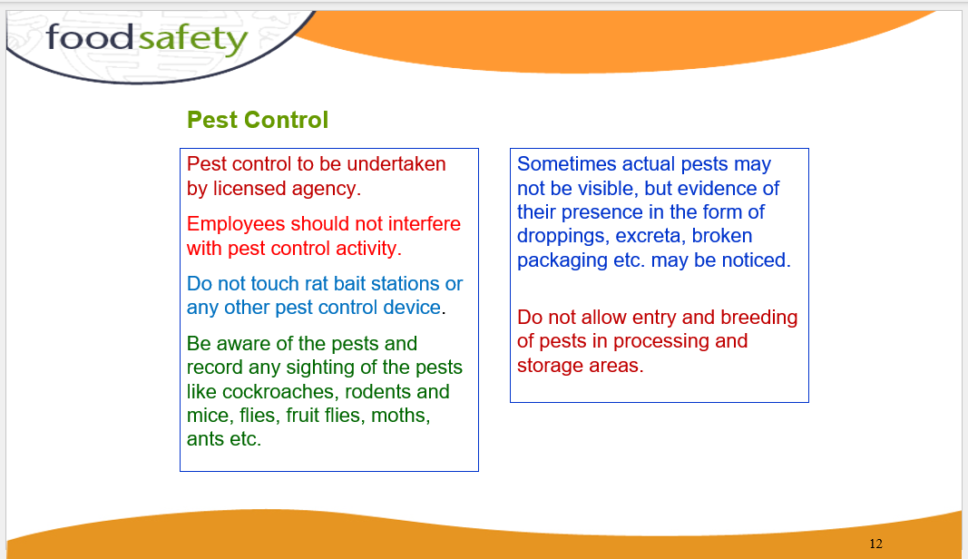

Slide 14
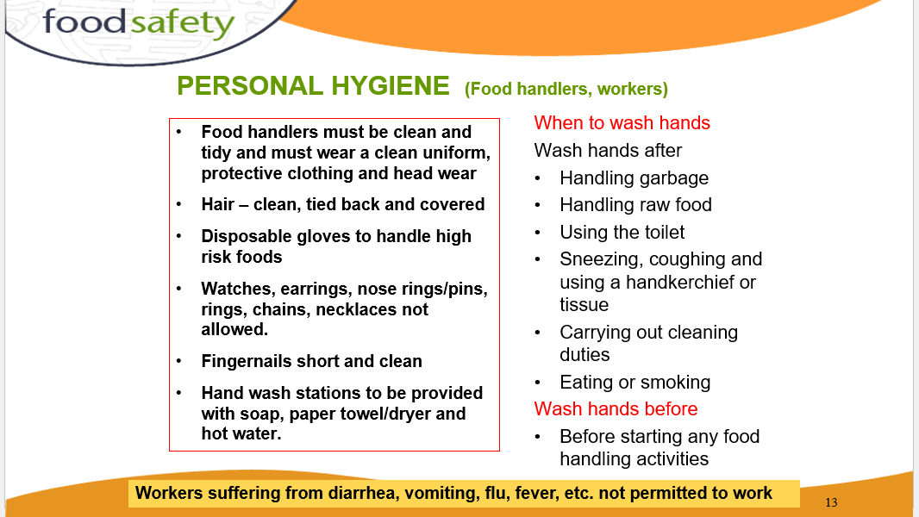

Slide 15
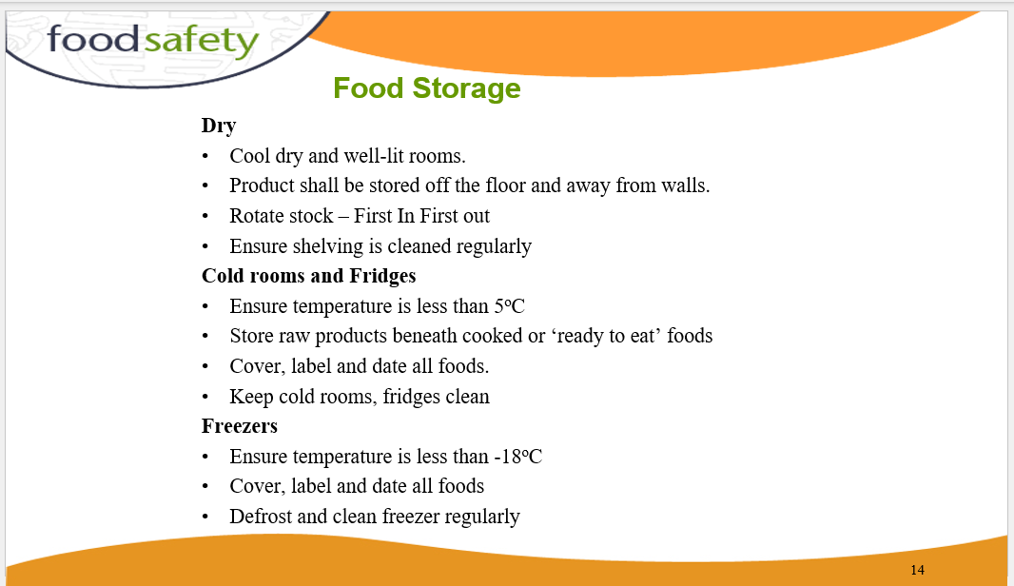

Slide 16
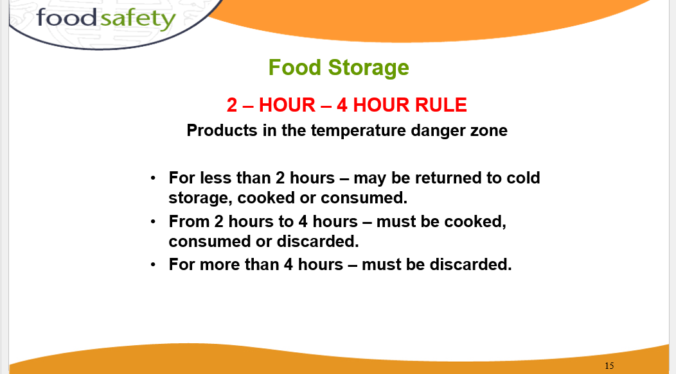

Slide 17
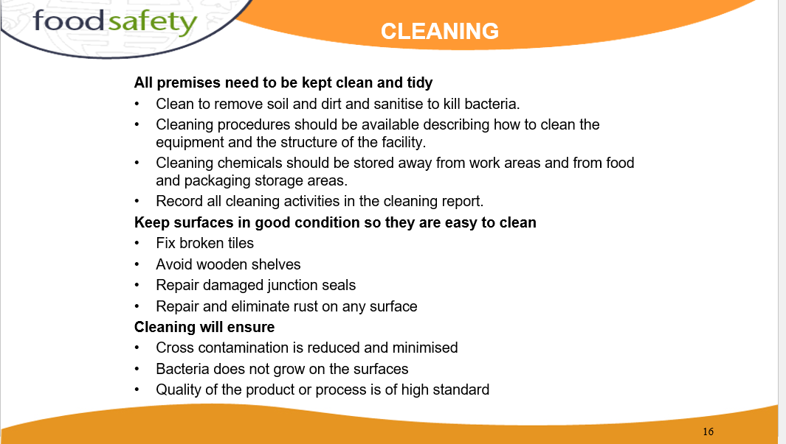

Slide 18
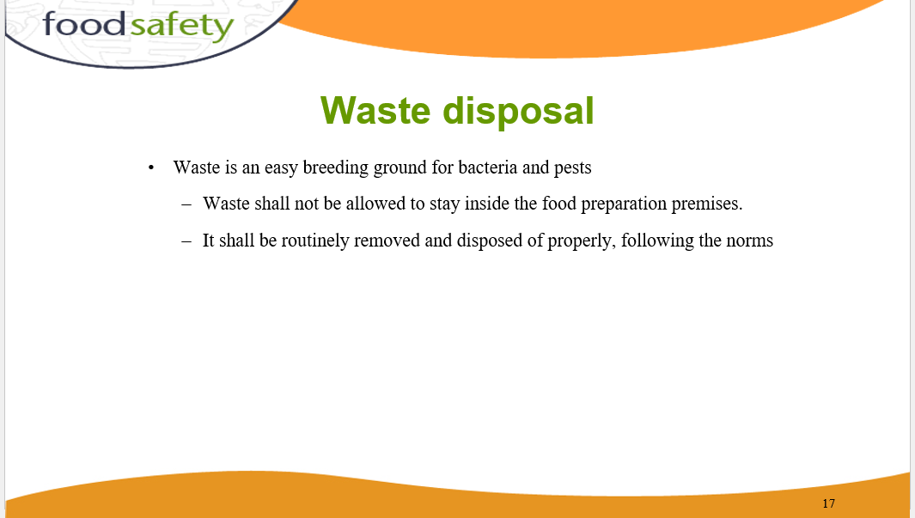

Slide 19
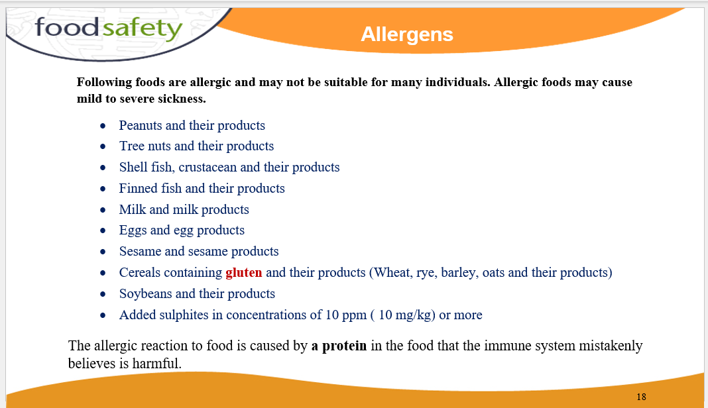
An allergen is a substance that can cause an allergic reaction. In some people, the immune system recognizes allergens as foreign or dangerous. As a result, the immune system reacts by making a type of antibody called immunoglobulin E (IgE) to defend against the allergen.

Slide 20
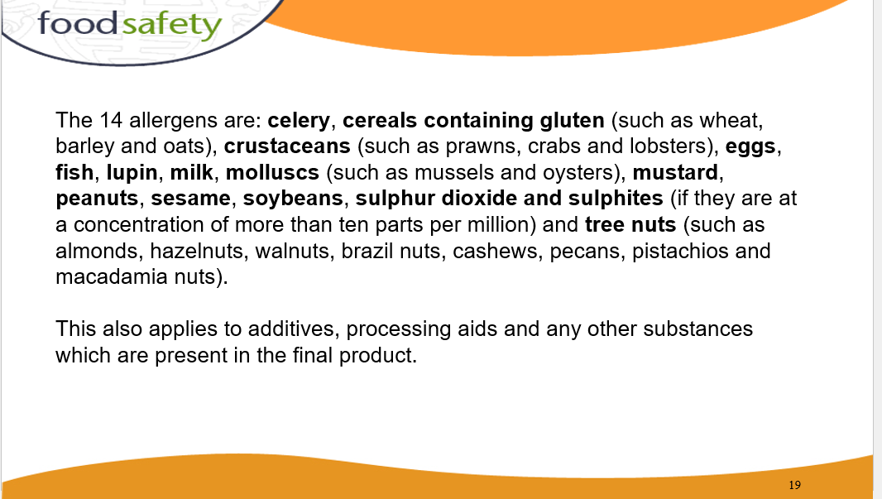

Slide 21
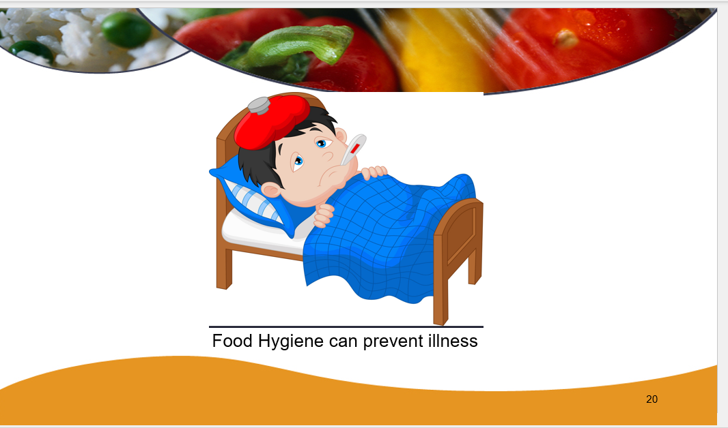

Slide 22
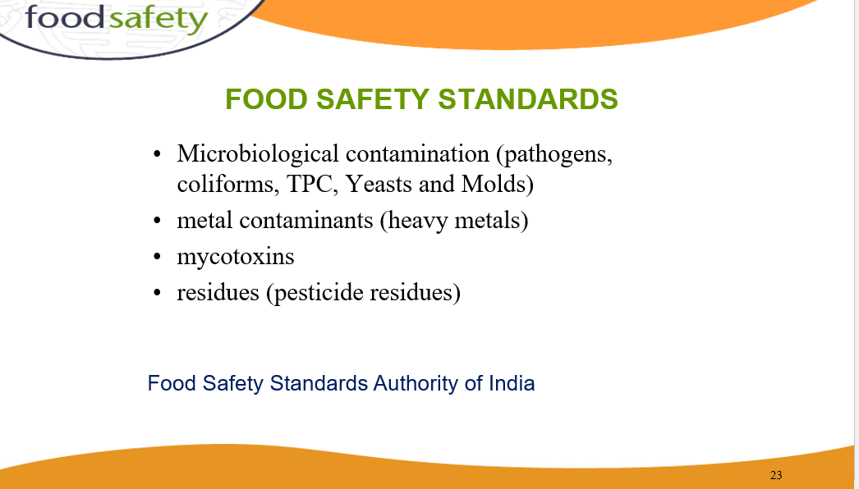

Slide 23
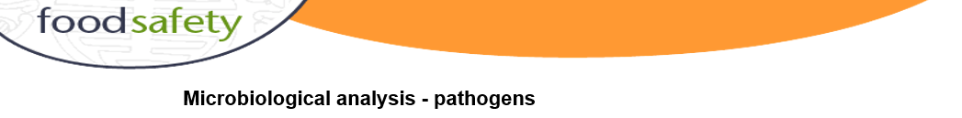
Microbiological analyses are extremely sensitive: just a single infectious particle may be detected in volumes of up to 1000 l of water.
The weight of a bacterium is in the order of 10⁻¹² g;
the weight of a virus may be as low as 10⁻¹⁷ g.
Hence, the limit of detection is between 10⁻¹⁵ and 10⁻²⁰ g l⁻¹.

Slide 24
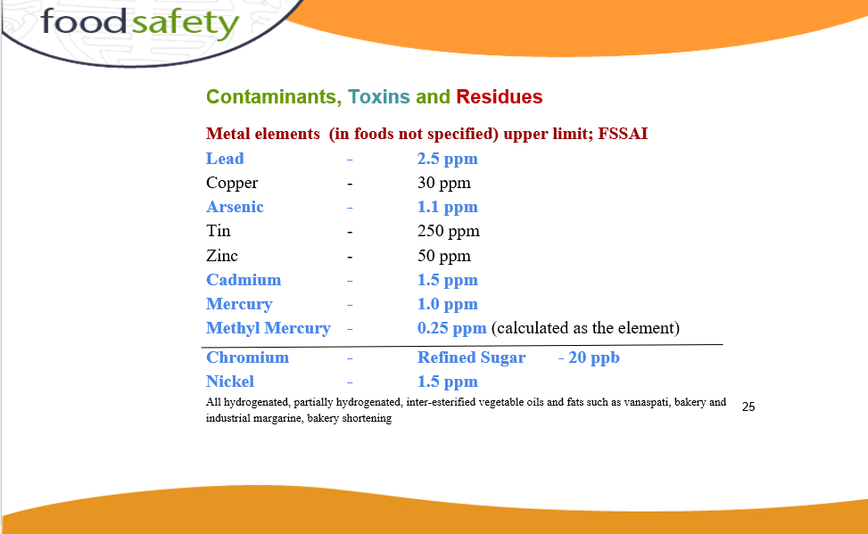

Slide 25
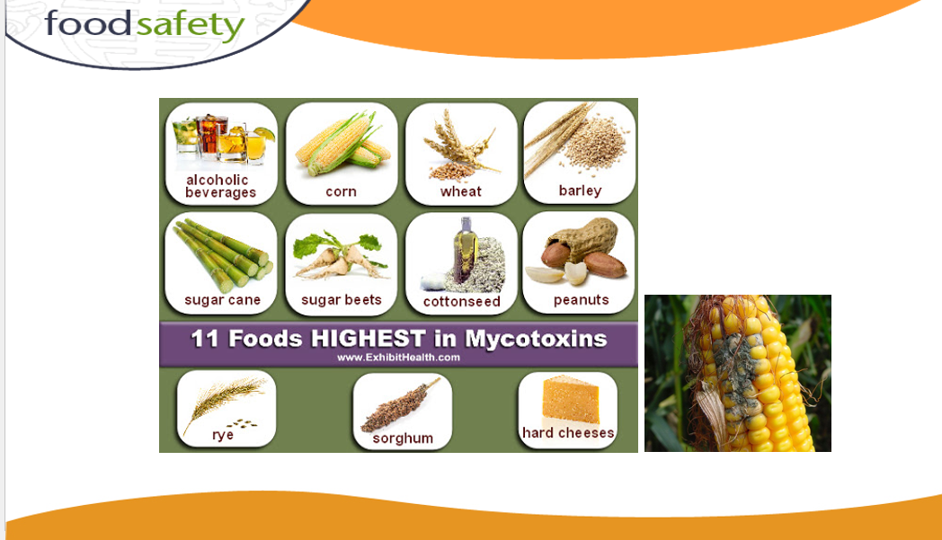
Mycotoxins are toxic compounds produced by certain types of fungi that can contaminate food and cause adverse health effects in humans and animals:

Slide 26
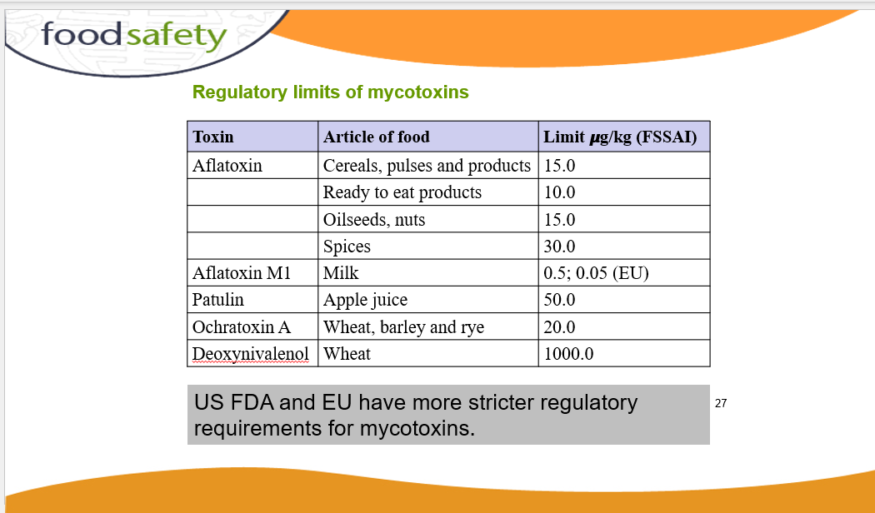

Slide 27
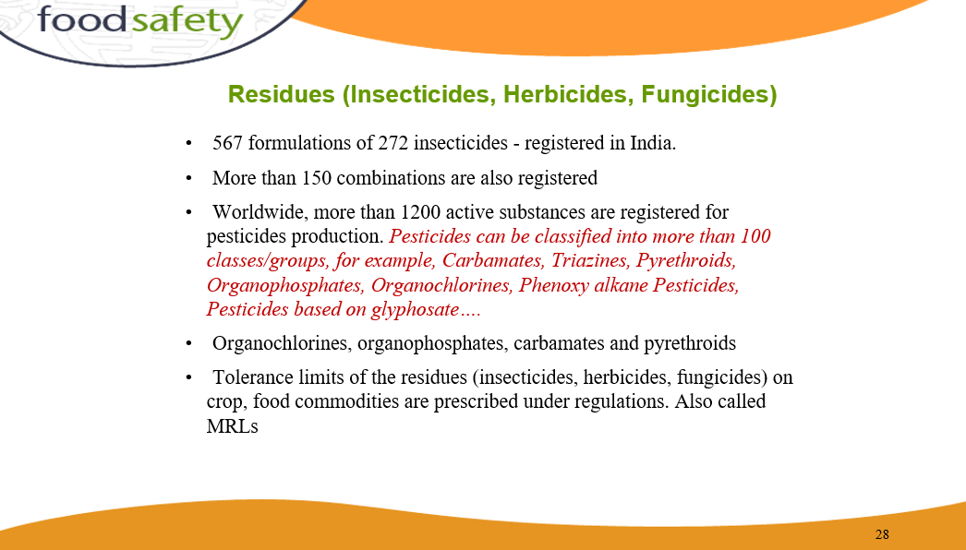

Slide 28
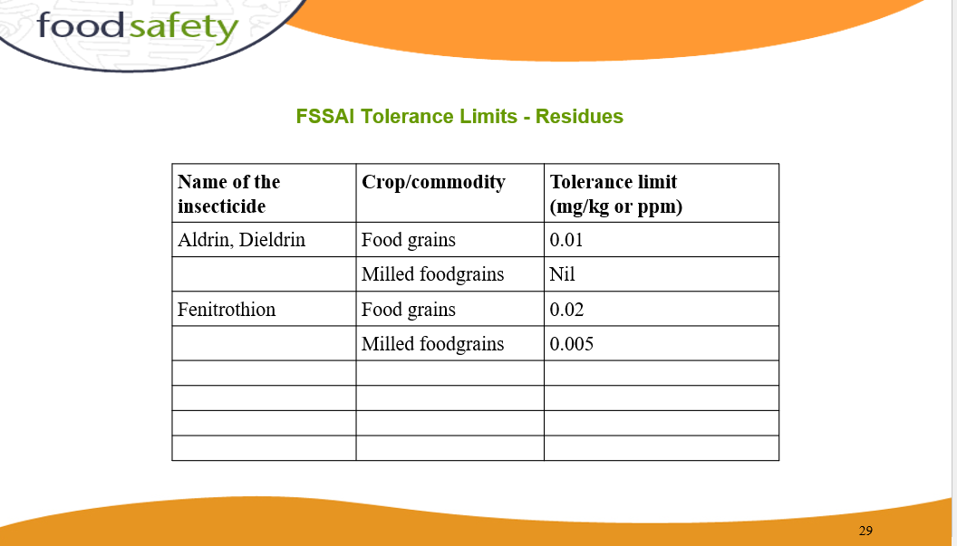

Slide 29
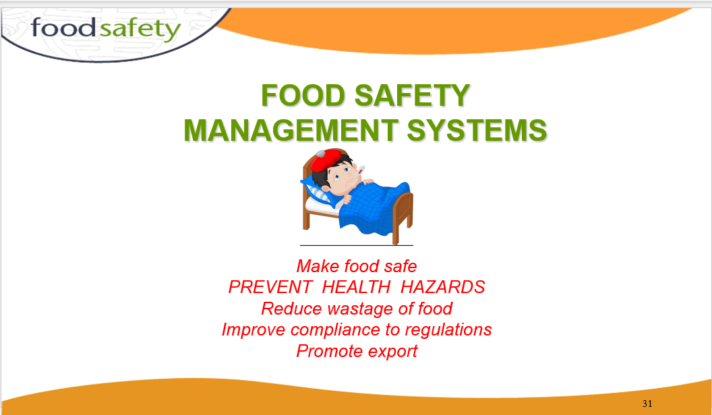

Slide 30
